Slide 1
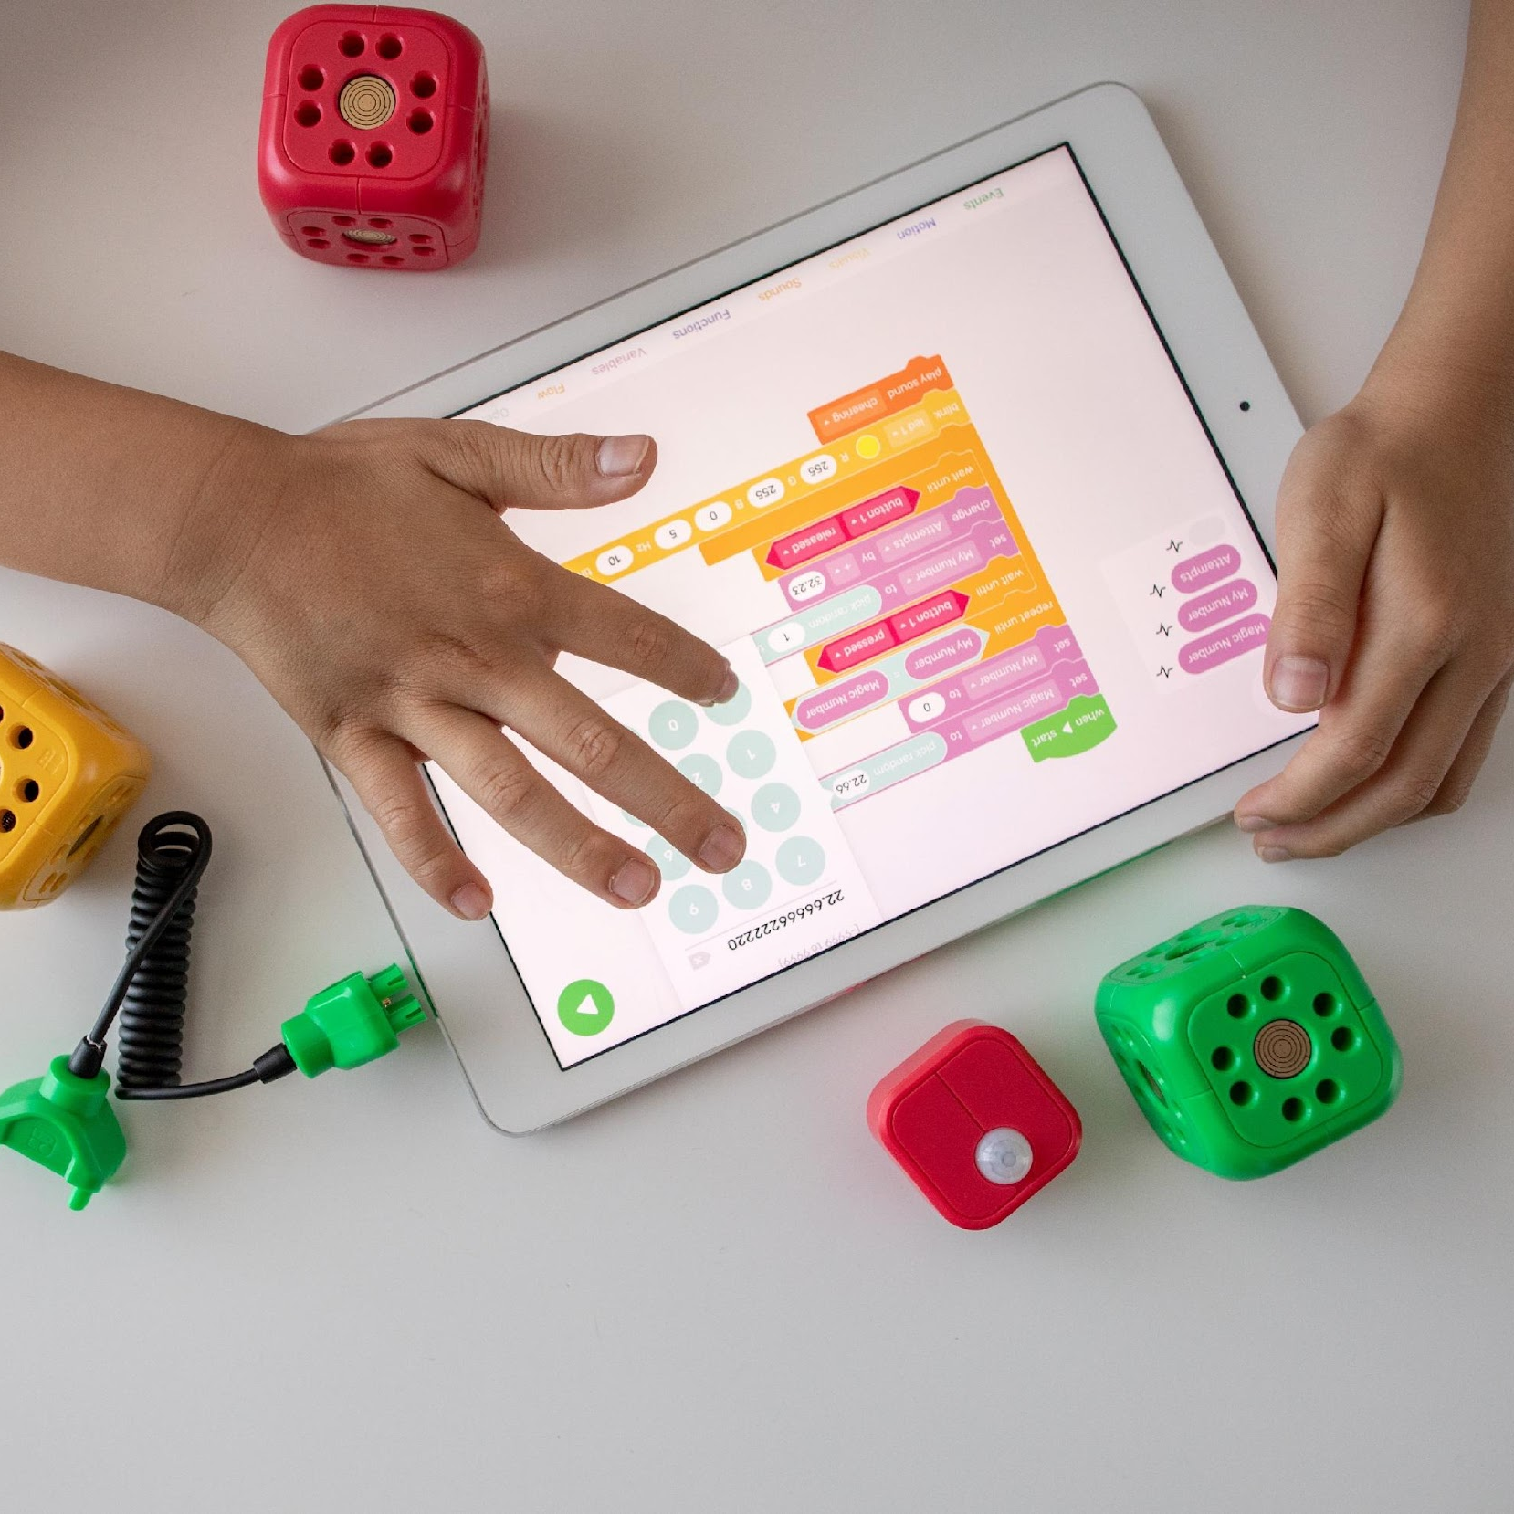



Capillary Action in Plants
Presentation by

Slide 2
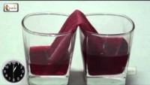
Capillary Action in Plants
What do you think will happen here

Slide 3
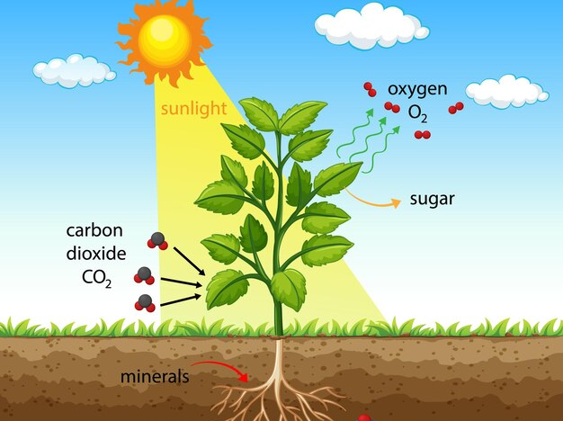
Capillary Action in Plants
What is this phenomenon of preparing food in plants called as?
Photosynthesis

Slide 4
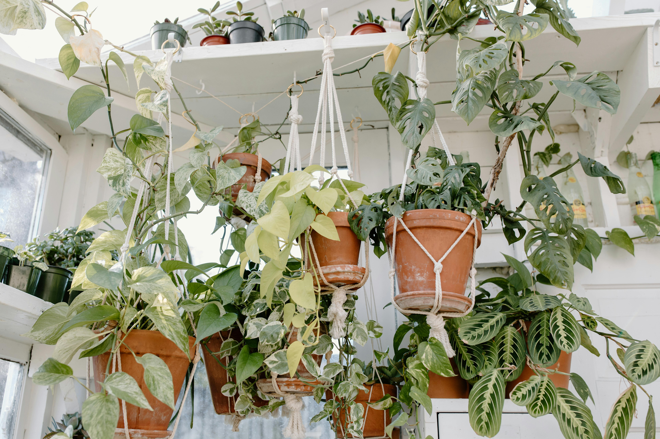
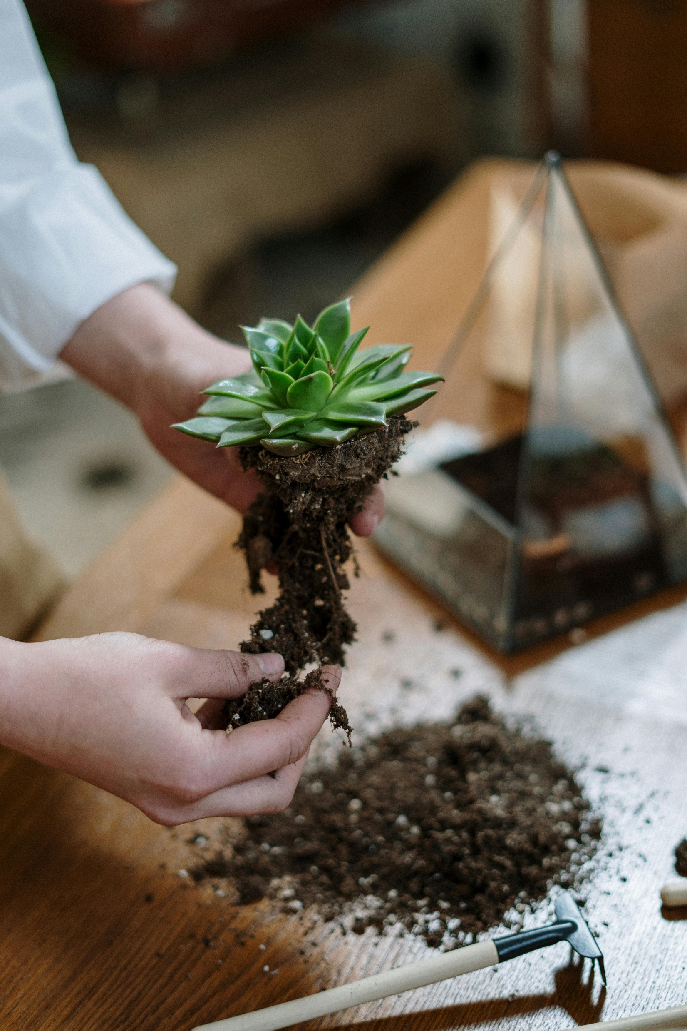
Capillary Action in Plants
What are the essential things required for Photosynthesis?
Sunlight
Water
Carbondioxide

Slide 5
Capillary Action in Plants
Capillary Action in Action
https://study.com/learn/lesson/capillary-action-plants-concept-importance.html

Slide 6
Capillary Action in Plants
My Make & Take Activity
Capillary Action in Flower
What would you need:
3 white flowers (or any light-coloured)
4 glasses or jars of water
4 different food colours

Slide 7
Thank You

